Slide 1
The Changes Behind Real-estate Pricing Trends
By Joshua Shleifer
Data 205 CRN 22017
Work done as part of an internship with the CFPB

Slide 2

Research goals and The importance of the question
Primary Goal: Analyze single-family property values and how the surrounding factors are influenced by changes in value. This would include (bust is not limited to) the demographic that lives in the area, the number of residential building permits that were issued, and the current median property value.
Originally I had intended to create a model to attempt to predict the future prices for a county, but that proved difficult as many of the factor that I expected to be strong indicators were barely correlated with the price change
Why is understanding real-estate price important?
In my opinion, a very significant part of the American dream is to be financially self-sufficient, which to many includes buying a house.
The current value to income ratio is the highest it has ever been: 5.6
This may make it difficult for many to become homeowners, and by understanding the problem we can seek to change it.

Slide 3
Datasets
Primary dataset: HMDA
Variables used for filtering:
Action taken (used to only pull loan applications)
Property value (some do not need to be reported, for example if the property value has no bearing on the application response)
Number of units (only using single family homes)
Derived data (for each year):
Mean/median property value by county
Count of applicants by race in each county (and a normalization)
Primary race of applicants in each county
Additional datasets:
Residential Construction Permits by County
Number of residential building permits by county and number of units
Missing many counties for some years
Citizens Connect - County Data
Demographics, number of commuters, median household income. Linked by county code.
Note that as of now this dataset only has data until 2020.
Unfortunately, the current version of the dataset seem to be missing information for the demographics. Their website says that they will update it soon, but at the moment the demographics section is unusable.

Slide 4
Tools used
HMDA Database
SQL
The database was created using many of the HMDA data science kit, updated to include the newest version of each dataset
Analysis and visualizations
I used python for all of the analysis
Package used: pandas, ast, numpy, scipy, matplotlib, seaborn, and plotly.

Slide 5
Descriptive Statistics
Overview of the change in County-level median prices by year
 | Mean | Standard Deviation | 25th percentile | 75th percentile
2019 | 1.080033 | 0.087094 | 1.041667 | 1.117647
2020 | 1.153442 | 0.097561 | 1.098361 | 1.193548
2021 | 1.068355 | 0.084272 | 1.00 | 1.115942
2022 | 1.075672 | 0.093195 | 1.00 | 1.131148
2023 | 1.029258 | 0.075076 | 1.00 | 1.067308

Slide 6
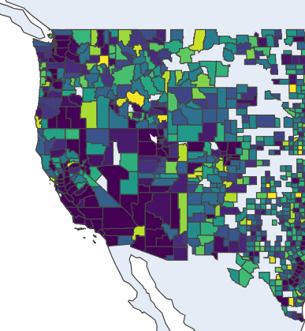
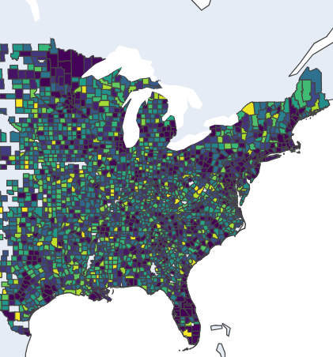
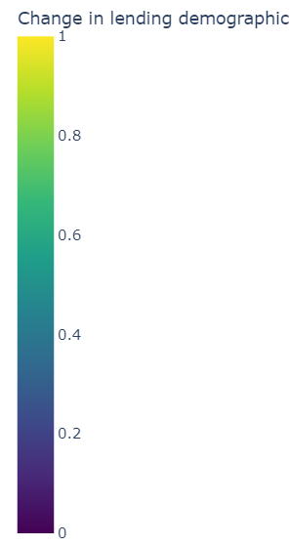
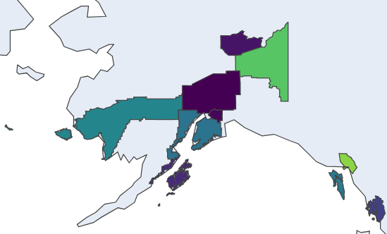

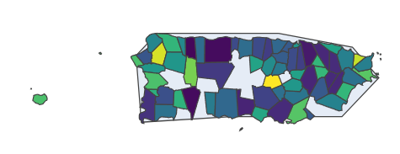
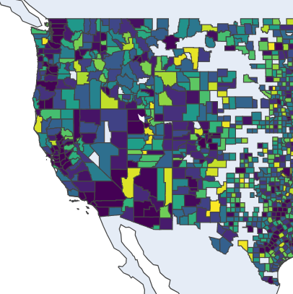
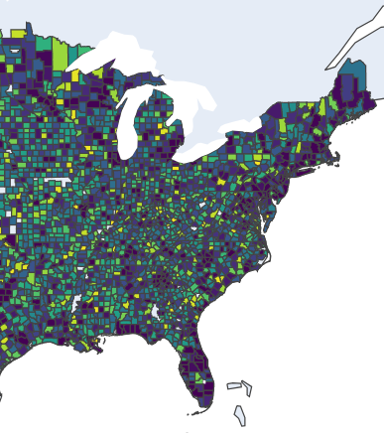
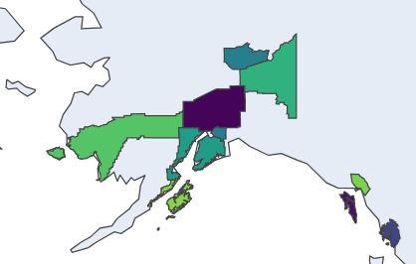


Significance of change in lending demographic
2019
(P-value so lower means higher confidence in the change)
2023

Slide 7
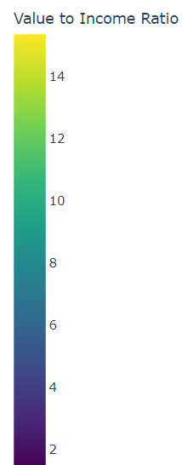
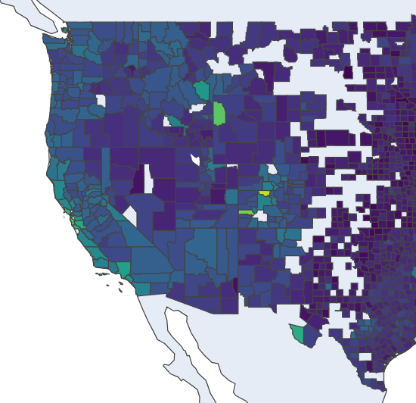
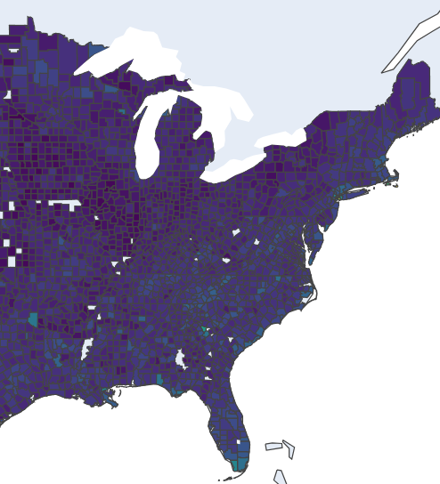
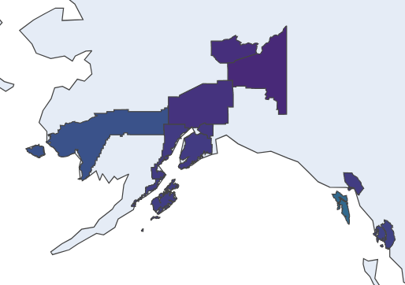


Property value to income ratio (Single family homes)

Slide 8
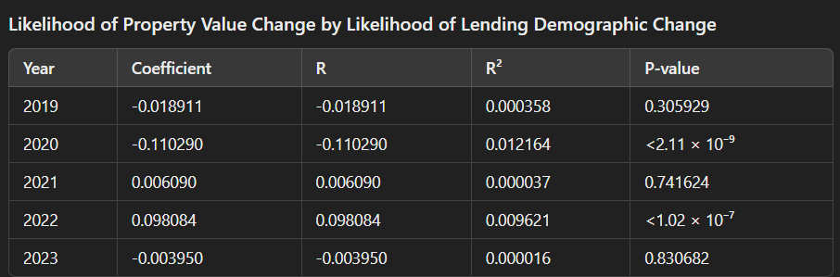
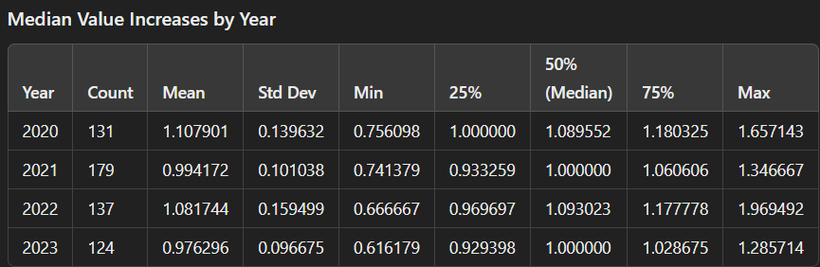
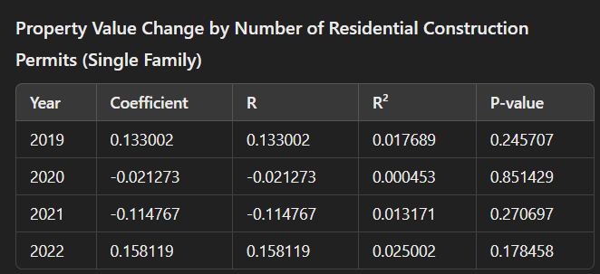
Final Data product
My original goal was to build a model to help predict the upcoming property value trends in a county. However, it seemed that none of the variable I tested were strong indicators for property value changes. (Note that more variables were tested than these. I included these only to demonstrate the results that I found for the rest.)

Slide 9
What does this tell us?
The lack of a significant relationship can be significant
The variables I tested included the p-value of the change in the lending demographic, the current value, previous increase, the number of construction permits, and the p-value for a change in commuters from an area. These are often things that are looked at or blamed for high real-estate prices in certain areas, and are often accompanied by the word “Gentrification”.
Either these factors are not causing property value jumps on a scale that can be measured by statistical analysis, or their significance is being vastly overstated.

Slide 10
Next steps
Improve the residential building permit data by filtering out disasters. (FEMA dataset)
Check if the lending demographic matches the demographic that lives in the area. (This data is currently missing but one may be able to derive it from the citizens-connect census tract data.)
Geographically model zoning legislation. Zoning laws strongly effect the supply of houses, which in turn effects the real-estate prices. These policies can also be directly controlled by those writing the legislations to control housing and living costs in an area.

Slide 11
Acknowledgments
My Data Professors
Professor R. Saidi
Professor M. Alraee
Professor A. Mohamed
Professor J. Valentine
My mentors at the CFPB
Mr. David Roell
Ms. Le Quyen
Mr. Alex Nongard

